Slide 1

Project Assignment 01
In this presentation we will explore the design process, handling of incorrect inputs, and related concepts from class.

Slide 2

Team Members and Roles
Tuna Boncu
Program Reviewer
Naina Kalra
Presentation
Ayla Bennett
Performance Analysis
Naomi Maurer
Documentation
Arezzio Rietti
Algorithm Design

Slide 3
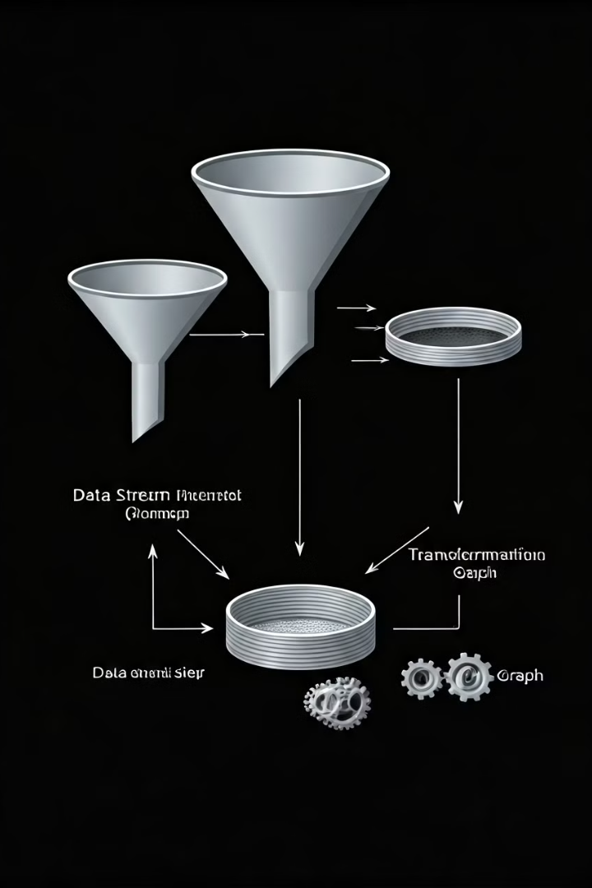
Algorithm Design and Approach
1: Input Validation
Receive inputs from the user: the number to be converted
(num), its base (b_num), and the target base (b_tar).
Check that b_num and b_tar are within the range 2-16.
This validation ensures the function only works
within supported bases.
2: Convert to Decimal (Base 10):
If the input number (num) is in any base other than
decimal, it first needs to be converted to decimal.
Use Python's int(num, b_num) to interpret the string num as a base-b_num number and convert it to an integer. This step enables easy manipulation and accurate base conversion since all number systems can be handled in decimal.

Slide 4
3: Convert Decimal to Target Base
Initialize an empty list, digits, to hold the digits of the converted number.
Using a loop, repeatedly divide the decimal number by the target base (b_tar),
storing the remainder each time.
Calculate the remainder using decimal_num % b_tar.
Convert this remainder to a character: if the remainder is less than 10, it's a regular digit; if it's 10 or more, convert it to an alphabetic character (A-F) using chr(remainder - 10 + ord('A')).
Append the result to digits.
Continue dividing until the quotient is zero.

Slide 5
4: Reverse and Format the Result
Since the conversion process gives digits in reverse order,
reverse the list digits and join it into a single string to produce
the final result in the target base.
5: Handle Edge Case (Zero)
If the decimal equivalent of num is 0, immediately return '0' as output. This avoids unnecessary processing for numbers that are zero in any base.
6: Output
Display the converted number

Slide 6

Handling Wrong Inputs
Input Validation
Error Handling
The algorithm validates incoming data to ensure it conforms to expected formats and ranges.
When invalid data is detected, the algorithm logs the error and continues processing valid data.

Slide 7
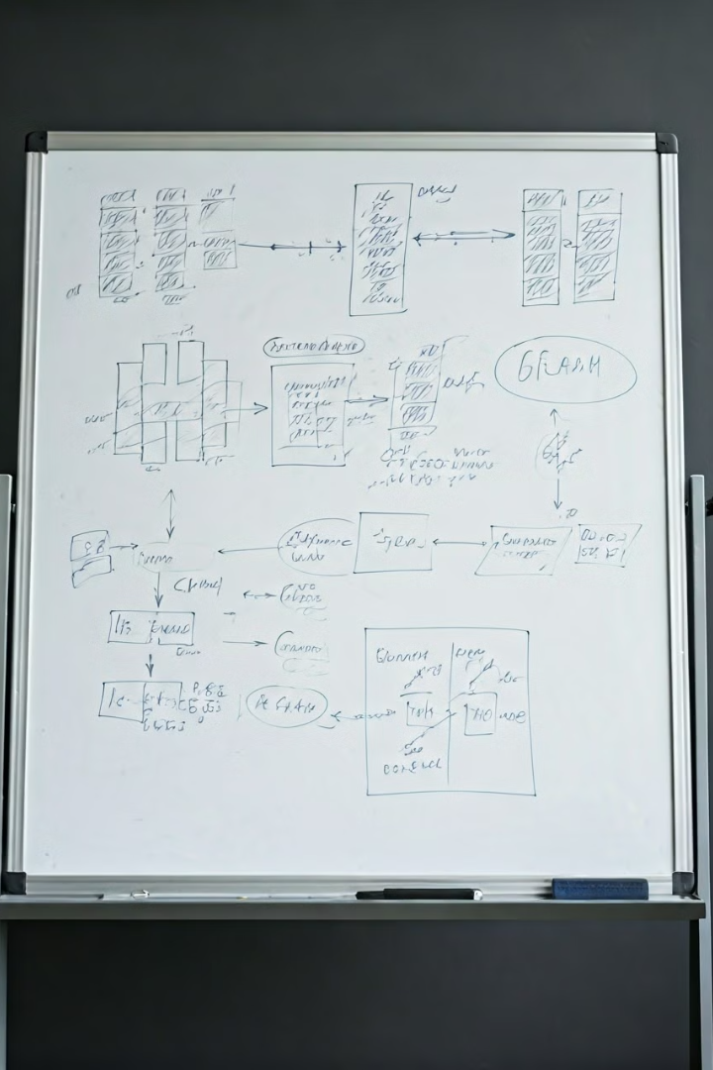
Related Concepts from Class
1
Data Structures
2
Algorithms
We used concepts like lists and variables to manage the constant data flow.
We applied various algorithms for data filtering, transformation, and analysis, including filtering and sorting.
3
Software Engineering
We incorporated design, testing, and error handling principles to ensure efficacy and preciseness.

